Slide 1
IPE 4111 Industrial Management p Technology management
Ahsanullah University of Science & Technology
|| HUM 3109: Industrial Management

Slide 2

Ahsanullah University of Science & Technology
|| HUM 3109: Industrial Management
What is Technology Management?
Technology refers to Information Technology (IT), which includes computer hardware/software, telecommunications, networks, and database.
Technology Management can also be defined as the integrated planning, design, optimization, operation and control of technological products, processes and services, a better definition would be the management of the use of technology for human advantage.

Slide 3
Ahsanullah University of Science & Technology
|| HUM 3109: Industrial Management
Key Tasks of MoT
The key tasks of MoT or Management of Technology are:
Technology Planning like deciding technology strategy, selecting appropriate technologies etc.
R&D Management
Innovation Management
Strategic Management of Technology (SMoT)

Slide 4

Innovation
Ahsanullah University of Science & Technology
|| HUM 3109: Industrial Management
Invention can be defined as the creation of a product or introduction of a process for the first time.
Innovation occurs if someone improves on or makes a significant contribution to an existing product, process or service.
Steve Jobs’ iPod is cited as an example of innovation at its best. The iPod wasn’t the first portable music device (Sony popularized the “music anywhere, anytime” concept 22 years earlier with the Walkman); the iPod wasn’t the first device that put hundreds of songs in our pocket.
What made Apple innovative was that it combined all of these elements — design, ergonomics and ease of use — in a single device, and then tied it directly into a platform that effortlessly kept that device updated with music.

Slide 5
Innovation Management
Ahsanullah University of Science & Technology
|| HUM 3109: Industrial Management
Venkatakrishnan Balasubramanian, a research analyst with Infosys Labs has offered five considerations to innovation management:
Competitive Advantage over other industries.
Business Alignment or the differentiating factors of your innovation should be conceptualized around the key strategic focus of the enterprise and its goals.
Knowing the Customers who will benefit from your innovation is paramount.
Identifying resources, processes, risks, partners and suppliers and Execution of these in the market are also important for succeeding in the innovation.
Business Value or assessing the value (monetary, market size, etc.) of the innovation and how the idea will bring that value into the organization is a critical underlying factor in selecting which idea to pursue.

Slide 6

Strategic Technology Management System
Ahsanullah University of Science & Technology
|| HUM 3109: Industrial Management
Strategic Technology Management System (STMS) emphasizes systematic management of technology (SMoT) on long term basis as the technology moves along its life cycle from birth to decline. It includes eight phases.

Slide 7
Phases of STMS
Ahsanullah University of Science & Technology
|| HUM 3109: Industrial Management
Technology Creation
Technology Monitoring
Technology Utilization
Technology Maturity
Technology Decline
Technology Assessment
Technology Acceptance
Technology Transfer
STMS Cycle

Slide 8
Phases of STMS
Ahsanullah University of Science & Technology
|| HUM 3109: Industrial Management
Technology Creation: This phase involves creation & generation of new technologies. This phase involves creativity, invention, innovation and developing requisite & supportive corporate culture for promoting technology creation and generation.
Technology Monitoring: This phase calls for monitoring technology trends and changes before implementing new technology. This phase involves Installing & developing information systems for monitoring technological trends and changes, Competitive analysis and Customer & supplier interfaces to understand market and technological changes.

Slide 9
Phases of STMS
Ahsanullah University of Science & Technology
|| HUM 3109: Industrial Management
Technology Assessment: This phase involves understanding directions of markets in terms of technology, integration of technology & business planning, etc.
Technology Transfer: This phase leads to transfer of technology from external source to own Research and Development (R&D); and internally from R&D to production. This phase involves Entering strategic alliances to develop or acquire potential technologies, Using product design teams effectively, Reducing functional barriers to technology transfer, etc.

Slide 10
Phases of STMS
Ahsanullah University of Science & Technology
|| HUM 3109: Industrial Management
Technology Acceptance: This phase calls for acceptance of technology as a beneficial change and involves Supportive organizational design & structures, Senior management commitment, Supportive corporate culture, etc.
Technology Utilization: This phase leads to technology growth as reflected by increase in sales. This phase involves Effective project management for seeking maximum utilization, Supportive marketing strategies, efforts and utilizing feedback for improvement, etc.

Slide 11
Phases of STMS
Ahsanullah University of Science & Technology
|| HUM 3109: Industrial Management
Technology Maturity: This phase involves analyzing maturity of existing technology and its related products/services/processes through study of following indicators, Efficiency vs. effectiveness contributed by the current technologies, Market stability, etc.
Technology Decline: This is the last phase. During this phase a technology and its related products/services/proceses/applications show substantial or sharp decline in usage or applications or sales. Technology and its associated products or services become ordinary commodity. Technology degrades and becomes obsolete. This phase calls for movement to new technological opportunities.

Slide 12

Technology Life Cycle (TLC)
Ahsanullah University of Science & Technology
|| HUM 3109: Industrial Management
The Technology Life Cycle (TLC) describes the costs and profits of a product from technological development phase to market maturity to eventual decline.
Due to rapidly increasing rates of innovation, products such as electronics and pharmaceuticals in particular are vulnerable to shorter life cycles. Thus TLC is focused primarily on the time and cost of development as it relates to the projected profits. TLC can be described as having four distinct stages.

Slide 13
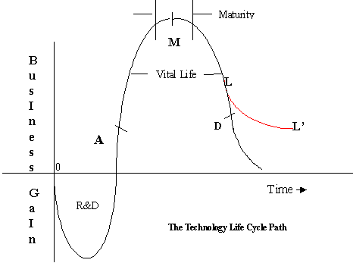
Technology Life Cycle (TLC)
Ahsanullah University of Science & Technology
|| HUM 3109: Industrial Management
Illustration of the stages in the technological life cycle

Slide 14

Four Stages of TLC
Ahsanullah University of Science & Technology
|| HUM 3109: Industrial Management
Research and Development – During this stage, risks are taken to invest in technological innovations. By strategically directing R&D towards the most promising projects, companies and research institutions slowly work their way toward beta versions of new technologies.
Ascent Phase – This phase covers the timeframe from product invention to the point at which out-of-pocket costs are fully recovered. At this junction the goal is to see to the rapid growth and distribution of the invention and leverage the competitive advantage of having the newest and most effective product.

Slide 15
Four Stages of TLC
Ahsanullah University of Science & Technology
|| HUM 3109: Industrial Management
Maturity Stage – As the new innovation becomes accepted by the general population and competitors enter the market, supply begins to outstrip demand. During this stage, returns begin to slow as the concept becomes normalized.
Decline (or Decay) Phase – The final phase is when the utility and potential value to be captured in producing and selling the product begins dipping. This decline eventually reaches the point of a zero-sum game, where margins are no longer procured.

Slide 16
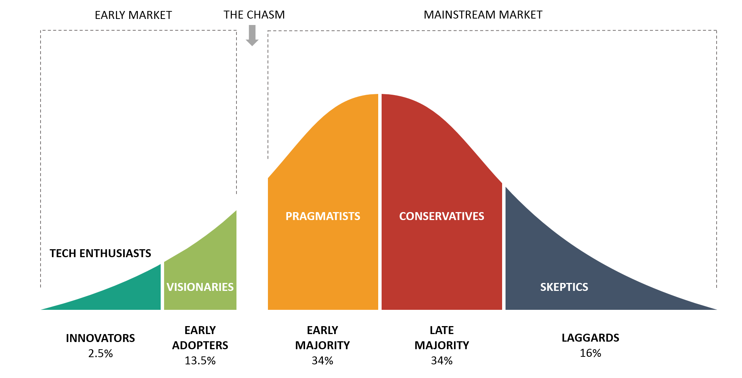
Technology Adoption Life Cycle
Ahsanullah University of Science & Technology
|| HUM 3109: Industrial Management
Technology Adoption Life Cycle highlights the way in which consumers embrace new products and services.

Slide 17
Technology Adoption Life Cycle
Ahsanullah University of Science & Technology
|| HUM 3109: Industrial Management
Innovators – These are risk-oriented, leading-edge minded individuals who are extremely interested in technological developments (often within a particular industry). Innovators are a fractional segment of the overall consumer population.
Early Adopters – A larger but still relatively small demographic, these individuals are generally risk-oriented and highly adaptable to new technology. Early adopters follow the innovators in embracing new products, and tend to be young and well-educated.
The chasm refers to the technology adoption lifecycle, or the transition from the early market into the mainstream sight. Crossing the chasm means the opportunity for hyper-growth and market success. It's the leap from being a new, little-known and exploratory product, to mass adoption and well-known status.

Slide 18
Technology Adoption Life Cycle
Ahsanullah University of Science & Technology
|| HUM 3109: Industrial Management
Early Majority – Much larger and more careful than the previous two groups, the early majority are open to new ideas but generally wait to see how they are received before investing.
Late Majority – Slightly conservative and risk-averse, the late majority is a large group of potential customers who need convincing before investing in something new.
Laggards – Extremely frugal, conservative, and often technology-averse, laggards are a small population of usually older and uneducated individuals who avoid risks and only invest in new ideas once they are extremely well-established.

Slide 19

Case Studies
Ahsanullah University of Science & Technology
|| HUM 3109: Industrial Management
Companies that experience innovation success grab onto it and believe that it is their secret to everlasting success. Unfortunately, this is not the case, although it would definitely make a CEOs job a lot easier.
There are some big companies, which is the victim of technology failure.
Some examples of famous corporations that suffered from innovation failure, including companies that have gone out of business will be discussed here.
For self-study:
https://www.valuer.ai/blog/50-examples-of-corporations-that-failed-to-innovate-and-missed-their-chance

Slide 20

Xerox
Ahsanullah University of Science & Technology
|| HUM 3109: Industrial Management
Xerox was actually first to invent the PC and their product was way ahead of its time. Unfortunately, the management thought going digital would be too expensive and they never bothered to exploit the opportunities they had.
The CEO David Kearns was convinced that the future of Xerox was in copy machines. The digital communication products invented weren’t seen as something that could replace black marks on white paper. Xerox failed to understand that you can’t keep perpetually making money on the same technology. Sometimes technology fails too.

Slide 21
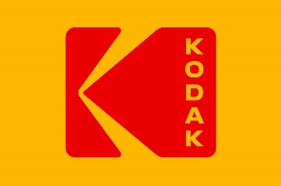
Kodak
Ahsanullah University of Science & Technology
|| HUM 3109: Industrial Management
In 1975, a young engineer at Kodak named Steve Sasson invented the digital camera. At first, it wasn't much to look at, weighing eight pounds and able to produce pictures of only 0.01 megapixels (today's iPhones produce 12 megapixels images, a 120,000% increase). He estimated at the time that it would take 15 to 20 years for the technology to become viable.
Being a silly big company with its head in the sand, the firm failed to pursue digital photography. New upstarts took over the market and prospered, while Kodak vanished into irrelevance. The company filed for bankruptcy in 2011.

Slide 22
Kodak
Ahsanullah University of Science & Technology
|| HUM 3109: Industrial Management
Once again, the truth is more complex. The company did, in fact, pursue the digital photography business in a serious way. It also made big investments in quality printing for digital photos. The problem was that it made most of its money on developing film, a business that completely disappeared.
It's tough to say what Kodak could have done. The only company that really seems to have profited from digital photography is Facebook and it's hard to see how Kodak would have had a competitive advantage in building social networks. The only real solution would have been to invent an entirely new business that could replace its cash cow (investment).

Slide 23

Nokia
Ahsanullah University of Science & Technology
|| HUM 3109: Industrial Management
Nokia, a company founded in Finland was the first to create a cellular network in the world. In the late 1990s and early 2000s, Nokia was the global leader in mobile phones.
With the arrival of the Internet, other mobile companies started understanding how data, not voice, was the future of communication. Nokia didn’t grasp the concept of software and kept focusing on hardware because the management feared to alienate current users if they changed too much.

Slide 24

Nokia
Ahsanullah University of Science & Technology
|| HUM 3109: Industrial Management
Nokia’s mistake was the fact that they didn’t want to lead the drastic change in user experience. This caused Nokia to develop a mess of an operating system with a bad user experience that just wasn’t a fit on the market.
The company overestimated the strength of its brand and believed they could arrive late in the smartphone game and succeed. In 2007 Steve Jobs launched the iPhone, a phone without a keyboard, which was revolutionary at the time. Really, watch the video and listen to people losing their minds the first time the watch someone using a touchscreen. In 2008 Nokia finally made the decision to compete with Android, but it was too late. Their products weren’t competitive enough.

Slide 25

Blockbuster
Ahsanullah University of Science & Technology
|| HUM 3109: Industrial Management
The video-rental company was at its peak in 2004. They survived the change from VHS to DVD but failed to innovate into a market that allowed for delivery (much less streaming).
While Netflix was shipping out DVD’s to their consumer’s homes, Blockbuster figured their physical stores were enough to please their customers. Because they had been the leader of the movie rental market for years, management didn’t see why they should change their strategy.

Slide 26
Blockbuster
Ahsanullah University of Science & Technology
|| HUM 3109: Industrial Management
Back in 2000, the founder of Netflix Reed Hastings proposed a partnership to the former CEO of Blockbuster John Antioco. Netflix wanted Blockbuster to advertise their brand in the stores while Netflix would run Blockbuster online. The idea got turned down by Antioco because he thought it was ridiculous and that Netflix’s business model was “niche business.” Little did he know that Hasting’s idea would have saved Blockbuster. In 2010 Blockbuster filed for bankruptcy and Netflix is now a $28 billion dollar company.
The Forbes article that aptly describes what exactly happened to Blockbuster, “The internet didn’t kill Blockbuster, the company did it to itself”

Slide 27

Borders
Ahsanullah University of Science & Technology
|| HUM 3109: Industrial Management
Borders Group opened its first bookstore in 1971 and they were a success for years. But in the mid- 2000s Borders failed to adapt to new technologies and never embraced the Internet like Amazon and Barnes & Noble. As more people began to order their books online, the fading of a giant like Borders was inevitable.
Amazon Kindle came out on in 2007, Barnes & Noble debuted Nook in 2009 and Apple’s iPad launched in 2010. Border’s Kobo (which is still alive) came out a little too late in 2011. It wasn’t just the Internet and competition that killed the company, it was their overall strategy. Borders opened too many stores making it harder to shed unprofitable locations and there were many. In 2011 Borders filed for bankruptcy, closing 399 stores and laying off 10,700 employees.

Slide 28
Ahsanullah University of Science & Technology
|| HUM 3109: Industrial Management
Thank You

